Slide 1


PLant Unit Monitor

Slide 2

Our Team
Adrian Cahyadi
Electrical Engineer

Slide 3



What is Plum?

Slide 4



Our Goal

Slide 5
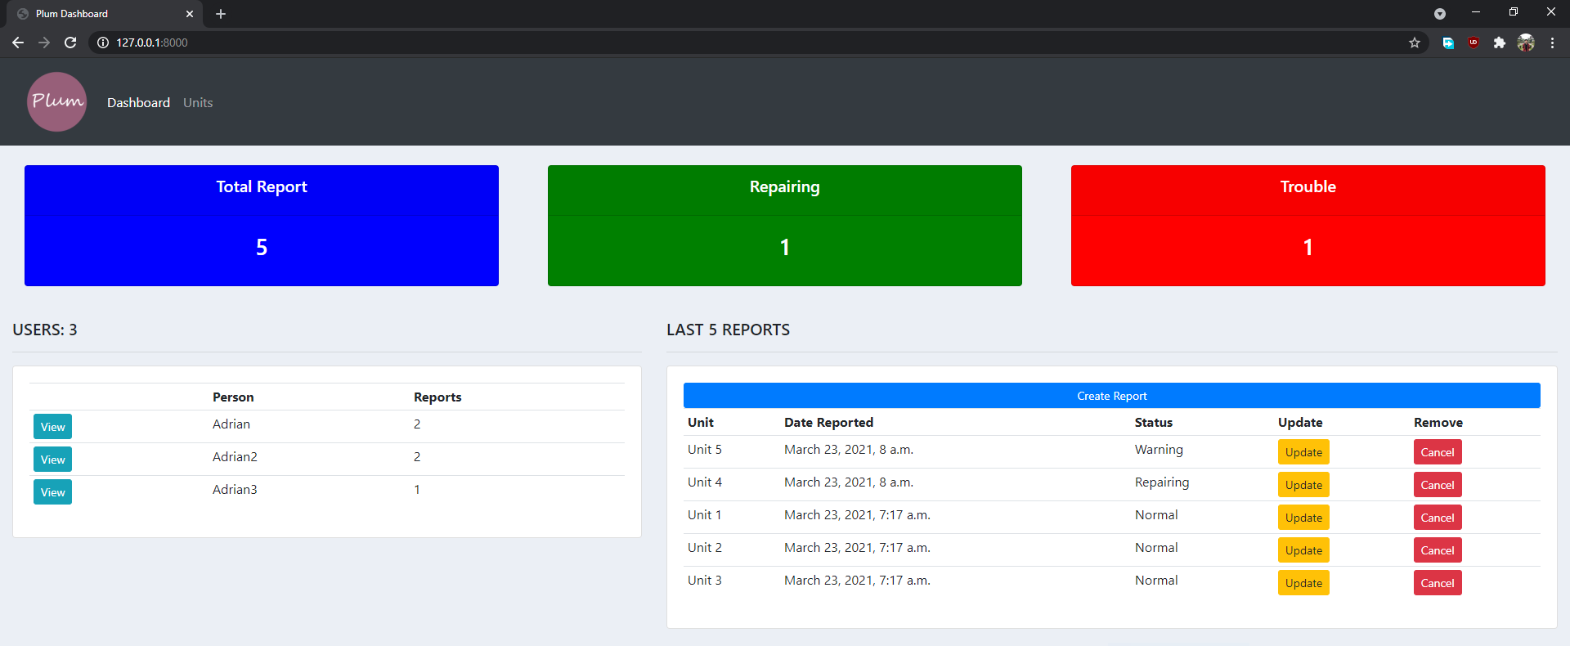
Main Page/Dashboard

Slide 6
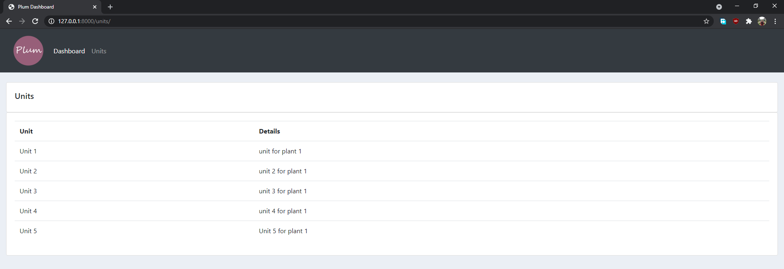
Units Page

Slide 7
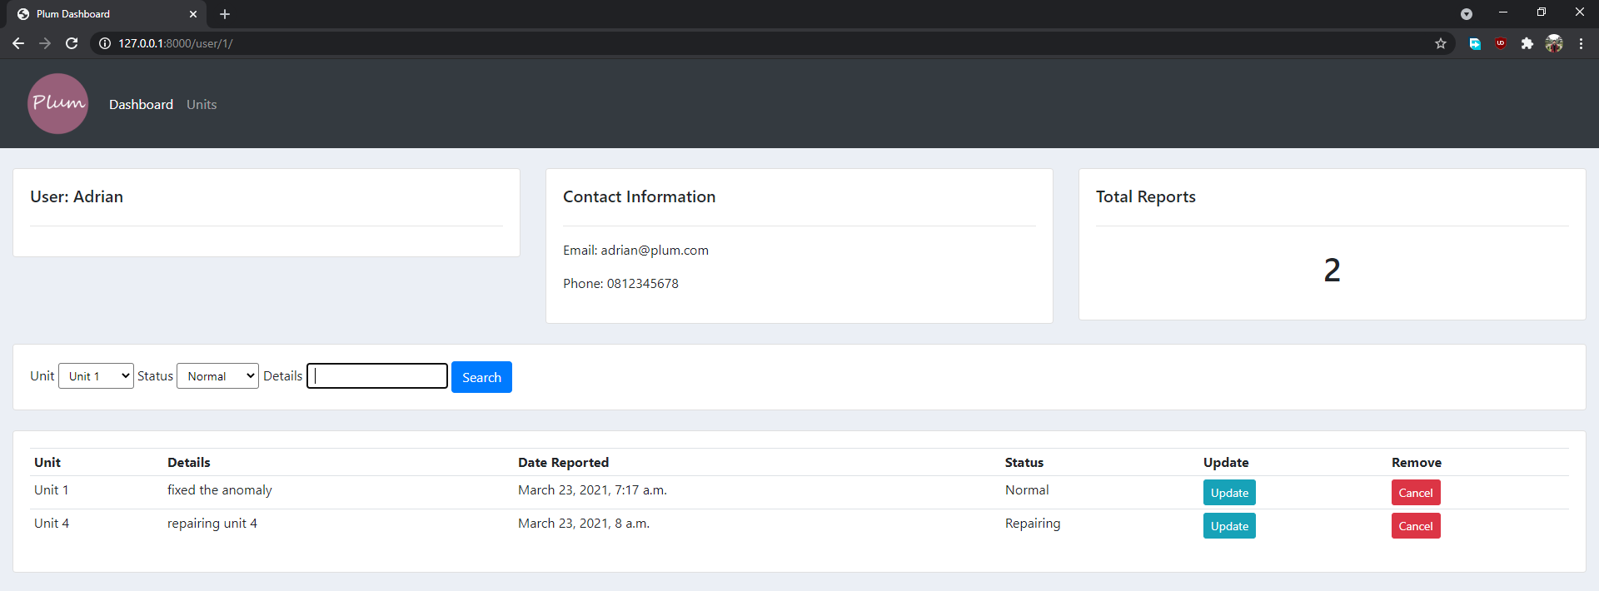
User Page

Slide 8
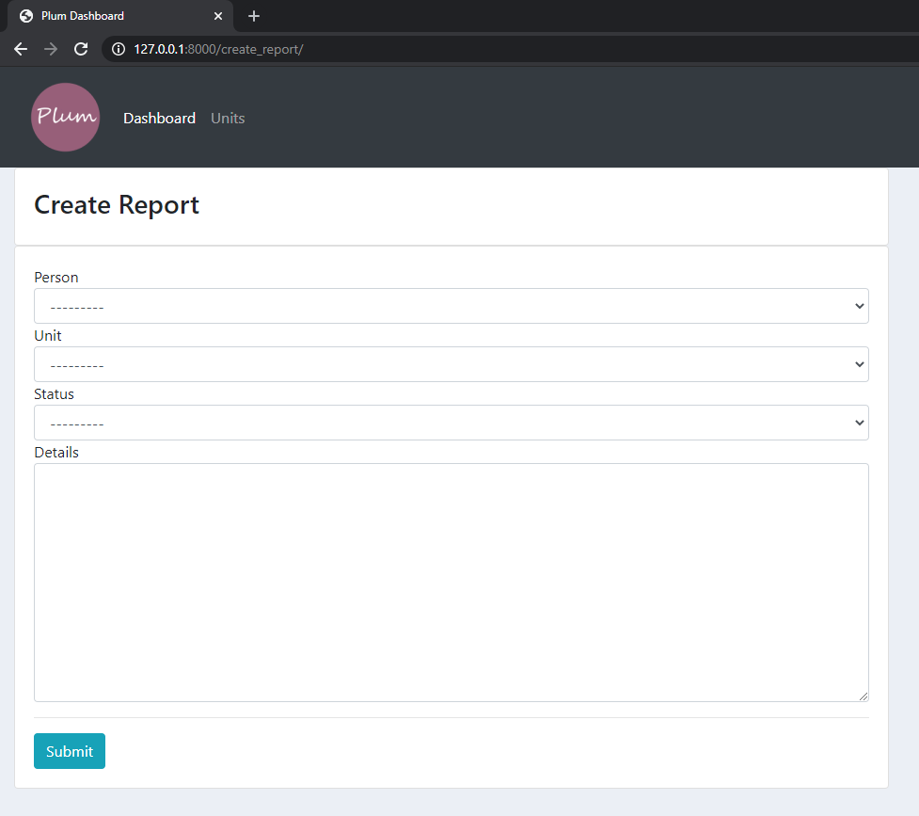
Create Report

Slide 9
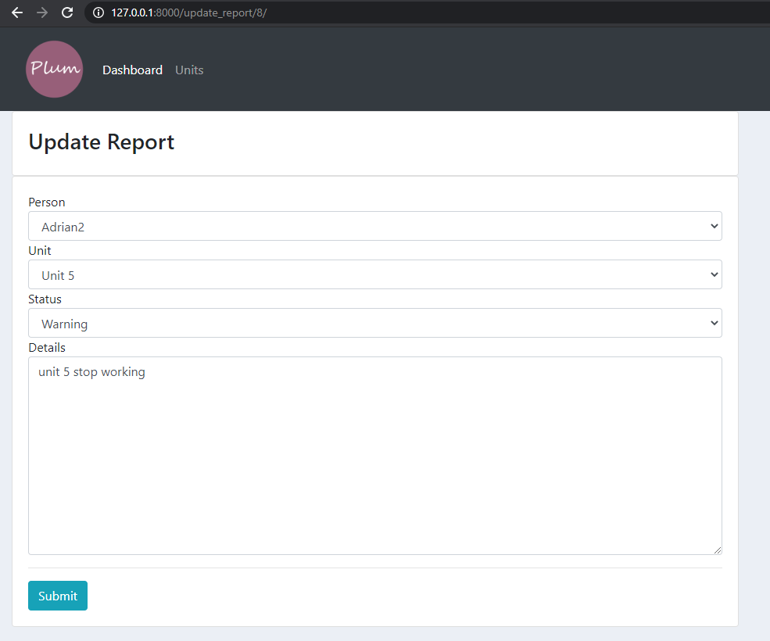
Update Report

Slide 10
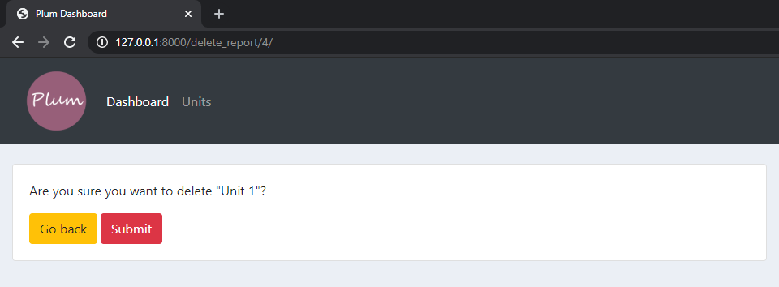
Delete Unit

Slide 11
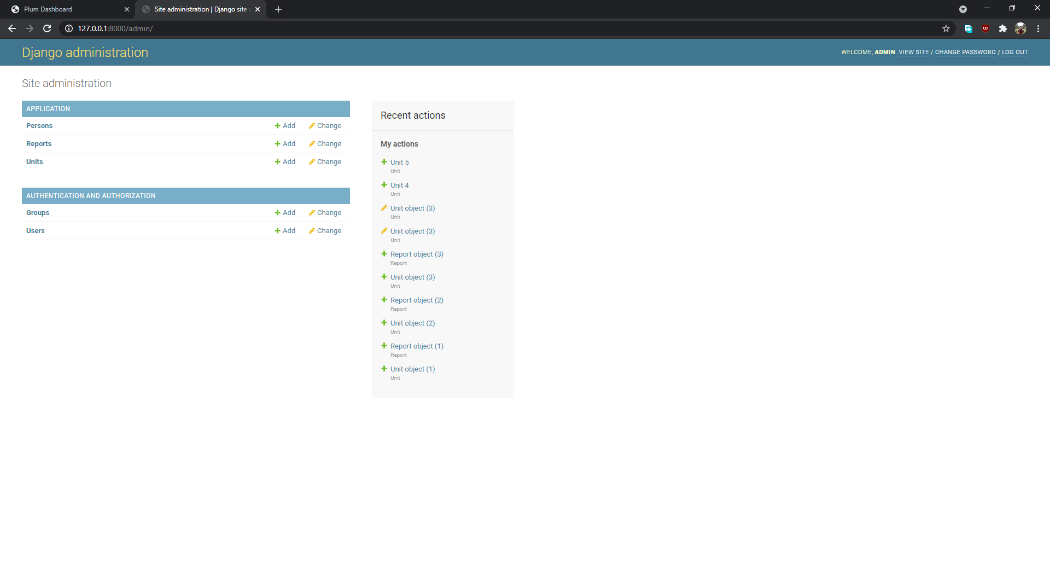
Add User and Unit via Django Admin

Slide 12



Technologies Used

Slide 13
Thank You!

